Slide 1
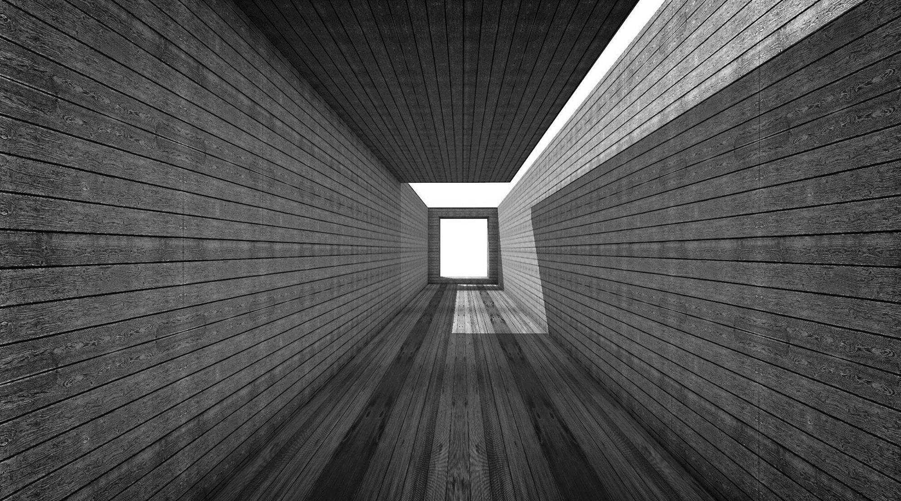
hw2

Slide 2
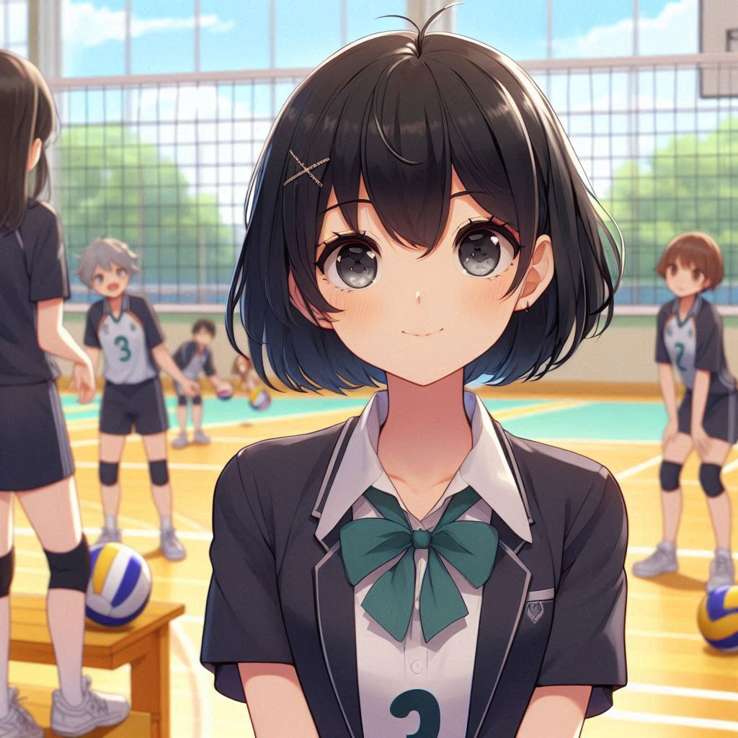
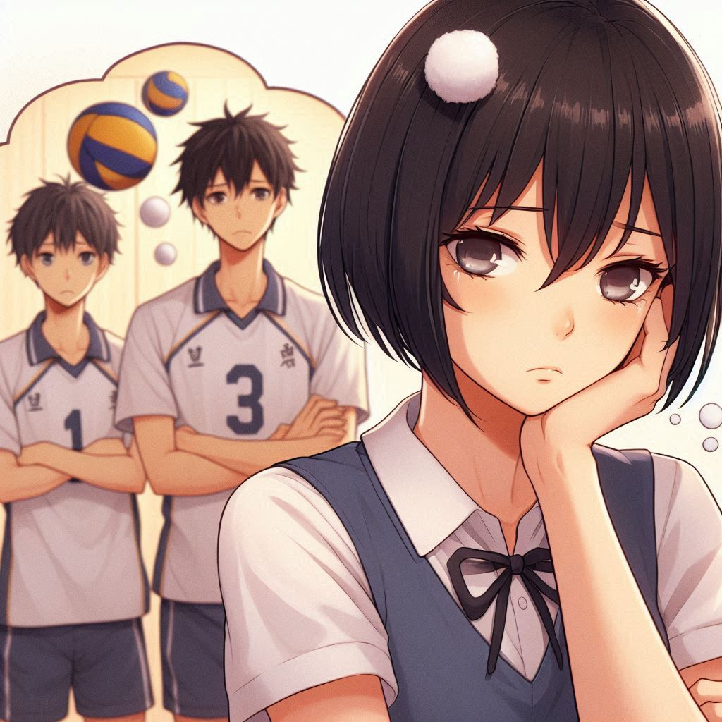
Prompt:生成一張黑色短髮的學妹在排球比賽場地，等待上場的樣子，神情很緊張。再放大主角以突顯興奮感。
講稿:在加入球隊後，我一直很期待能上場比賽，有一次剛好有機會和校外的球隊比賽，讓我感到興奮又緊張。我的目標是希望好好發揮，為我們系隊盡一份力。

Slide 3

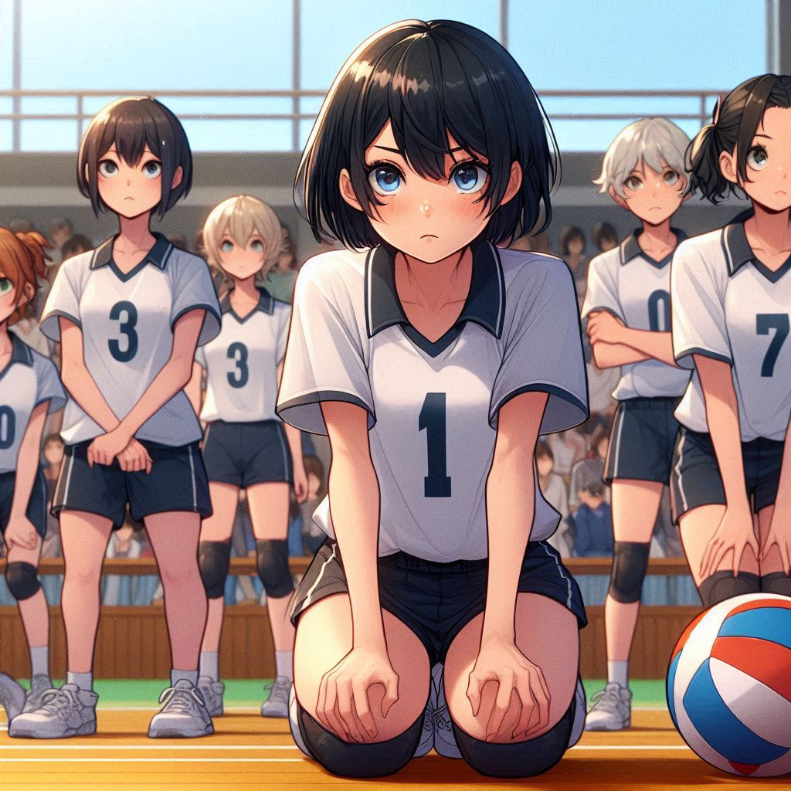
Prompt:生成一張黑色短髮的學妹在排球比賽場地，等待上場的樣子，神情很緊張。
講稿:因為這是我第一次參加比賽，我希望自己不要拖累隊友，也想讓學長姐看到我的進步。

Slide 4
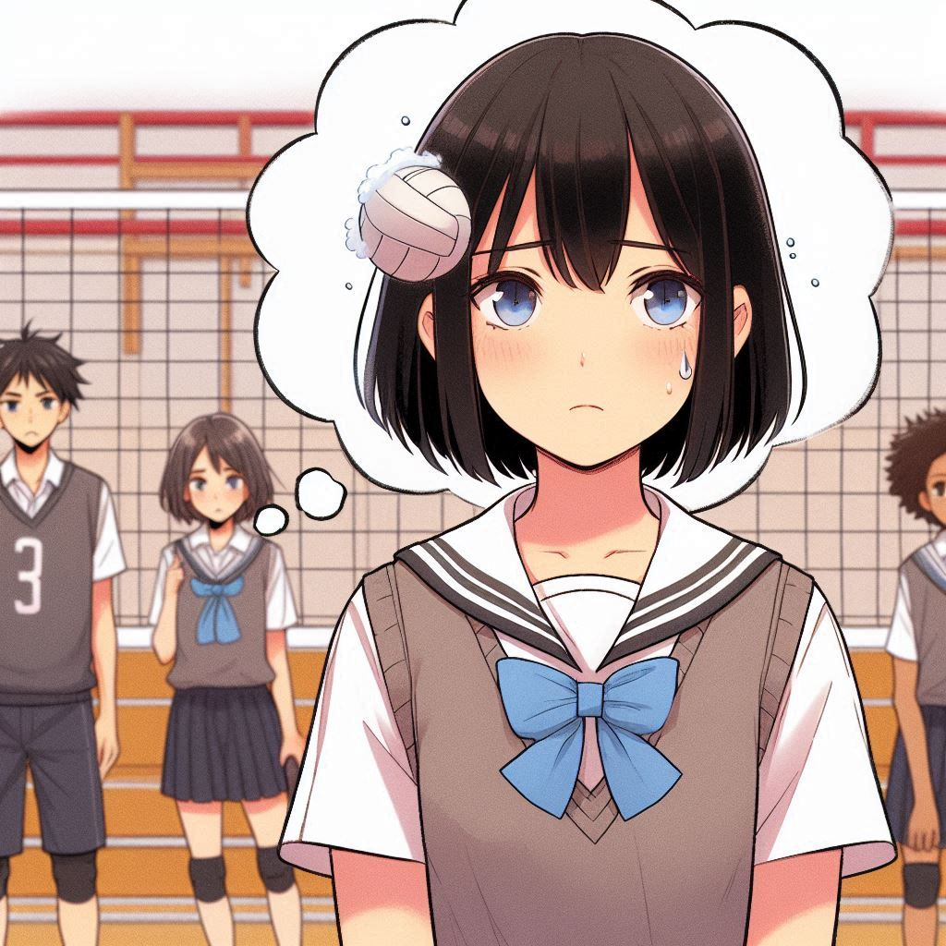
Prompt:A school girl with short black hair dreamed of losing a volleyball match. She looked very sad and had a group of teammates beside her.
講稿:隨著比賽日的接近，我越來越感到壓力。不僅是因為對手是校外的球隊，實力強勁，還因為我擔心自己的技術還不夠好，會犯錯或做得不夠好。

Slide 5

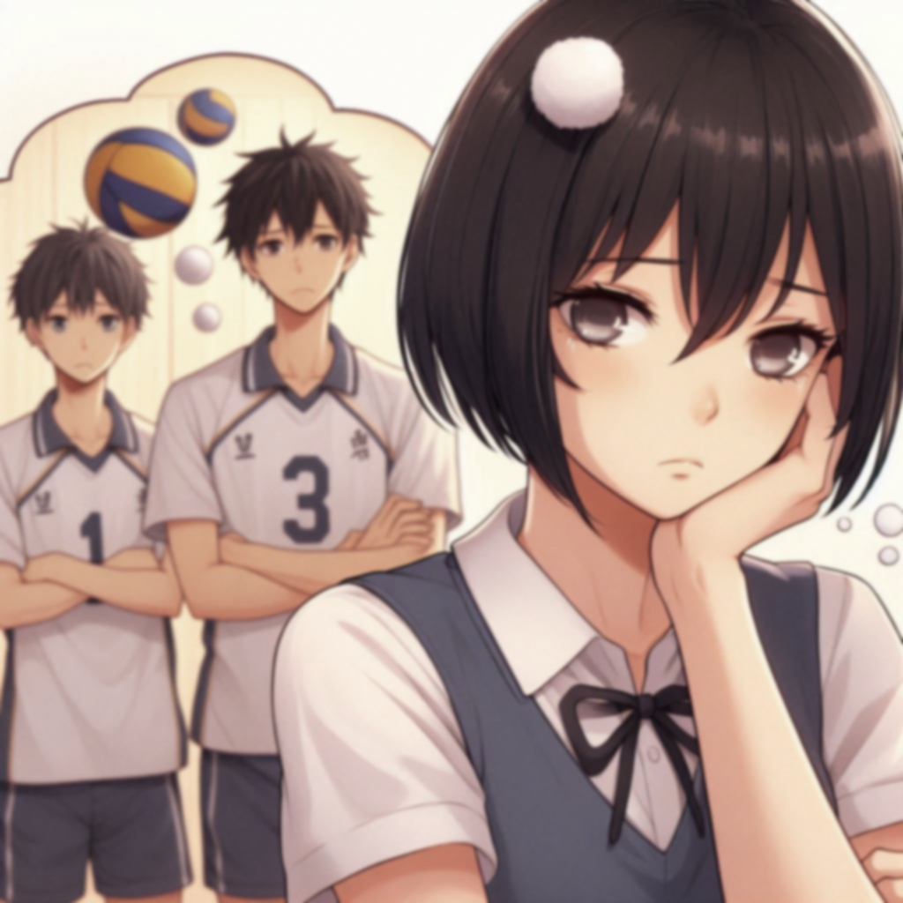
Prompt:A school girl with short black hair dreamed of losing a volleyball match. She looked very sad and had a group of teammates beside her.
講稿:比賽前，我腦海裡一直浮現著我可能會接不到球、扣球失誤，甚至讓大家失望的場景，這讓我內心非常焦慮。

Slide 6
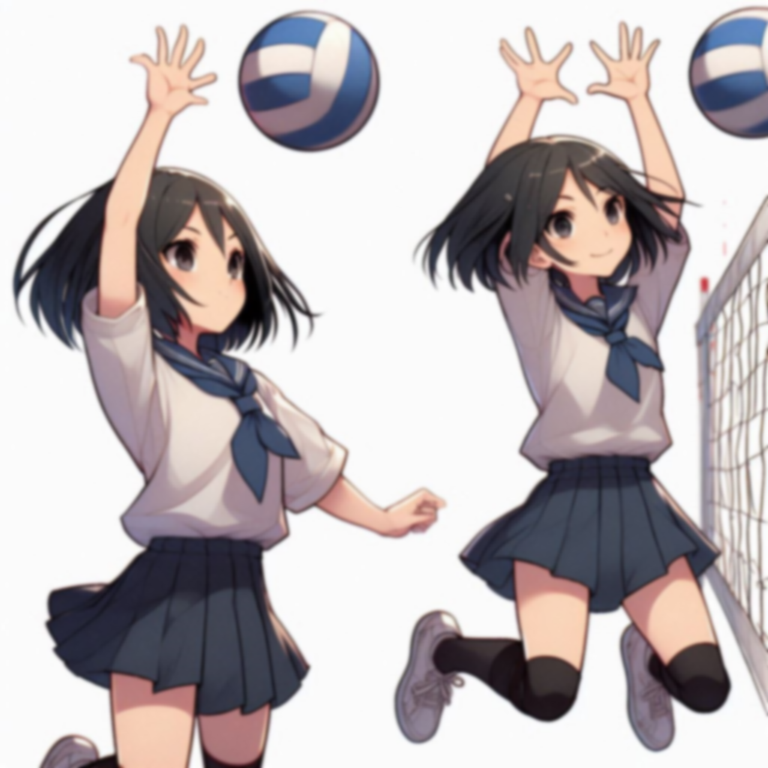
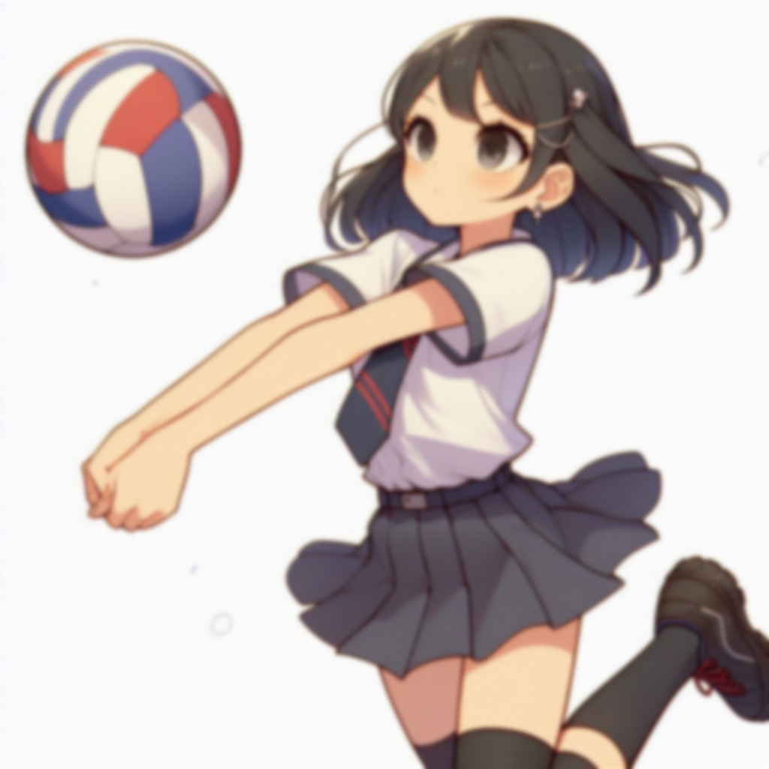
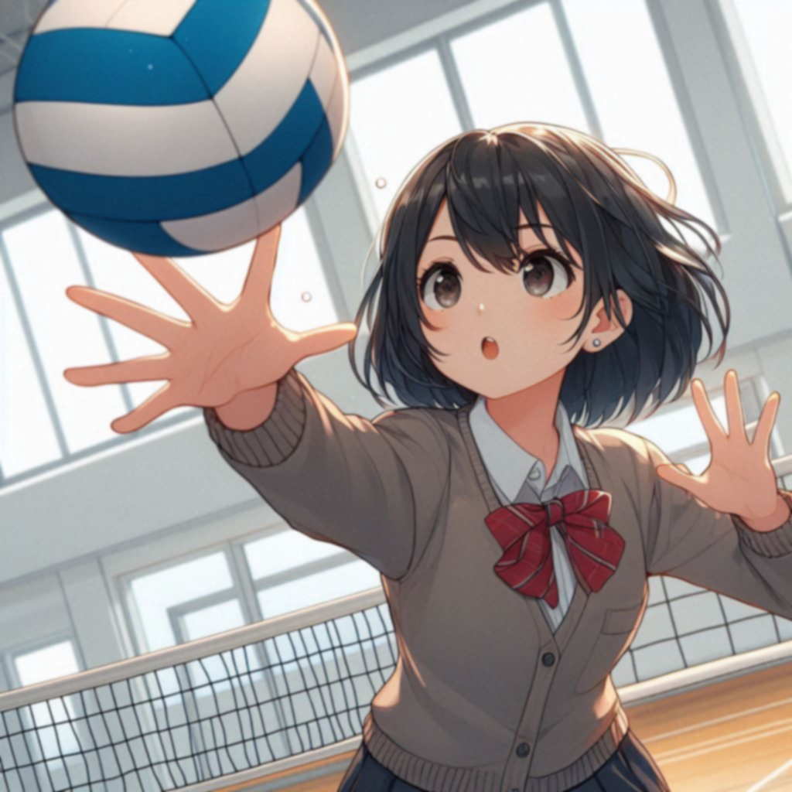
Prompt:She is a school girl with short black hair, who practices volleyball catching and spiking very seriously.
講稿:為了減少這種焦慮感，我開始更加認真地參與每次練習。不論是接發球還是扣球，我都拼盡全力去練習，希望能在比賽中做到最好。

Slide 7

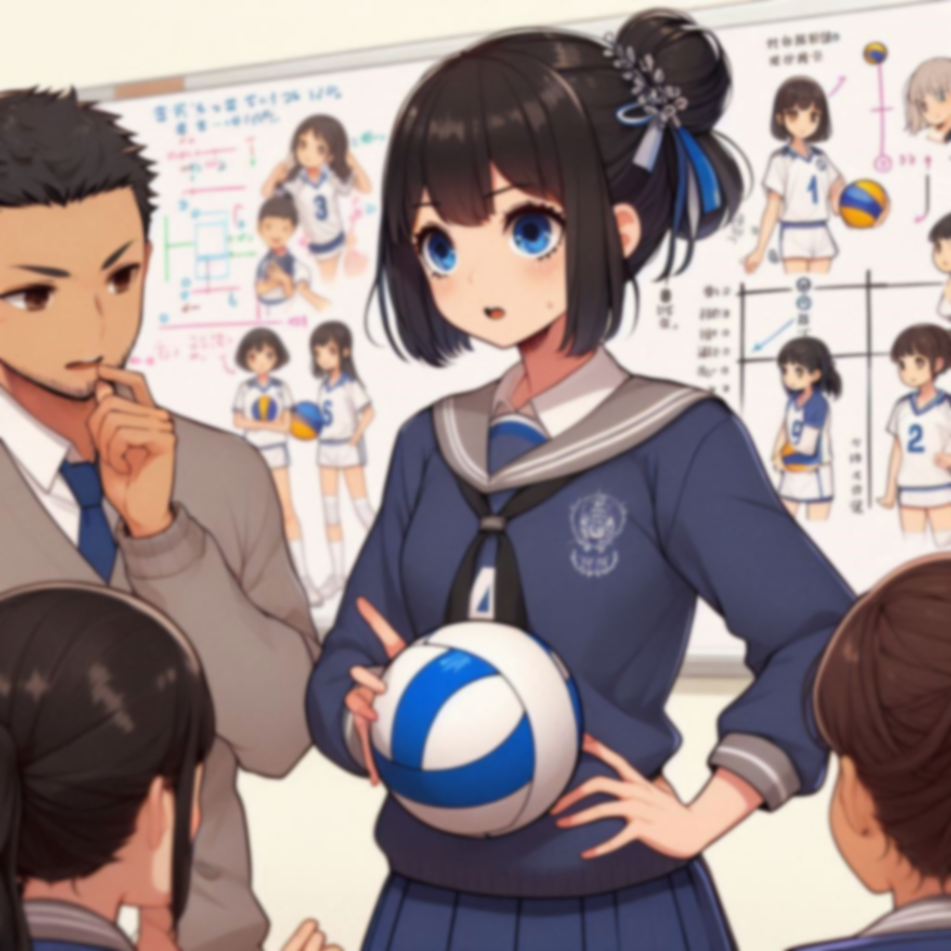
Prompt:Create a school girl with short black hair, practice coordination tactics with your teammates, and discuss strategies for dealing with different situations.
講稿:我還和隊友們一起練習配合戰術，討論應對不同局面的策略。比賽當天，我不斷深呼吸，告訴自己要專注於眼前的比賽，盡量保持冷靜。

Slide 8
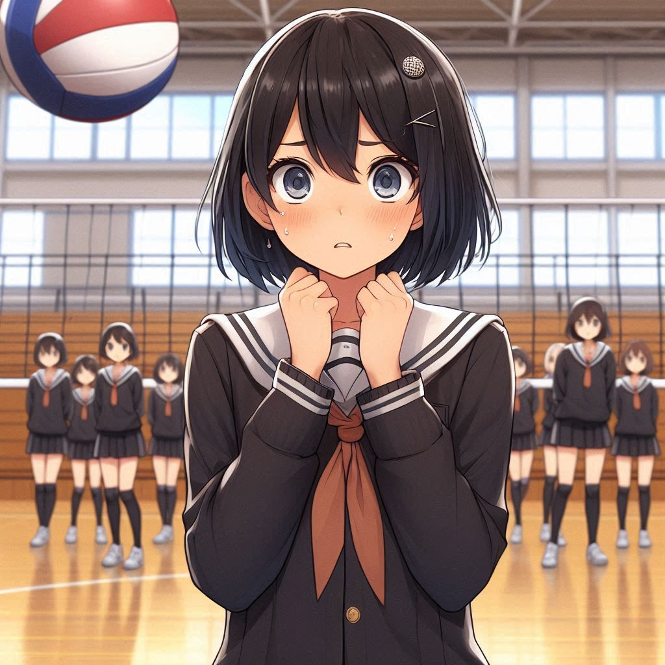
Prompt:A school girl with short black hair is born. Her heartbeat is racing and her palms are sweating on the volleyball court.
講稿:比賽一開始，我的心跳加速，手心也冒汗。

Slide 9
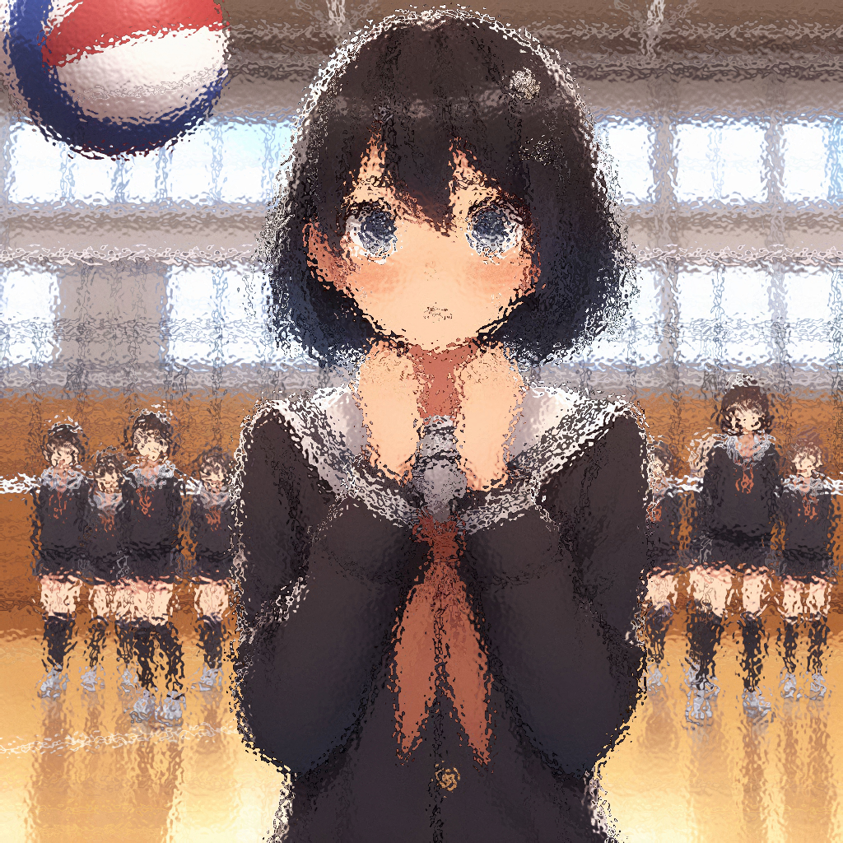
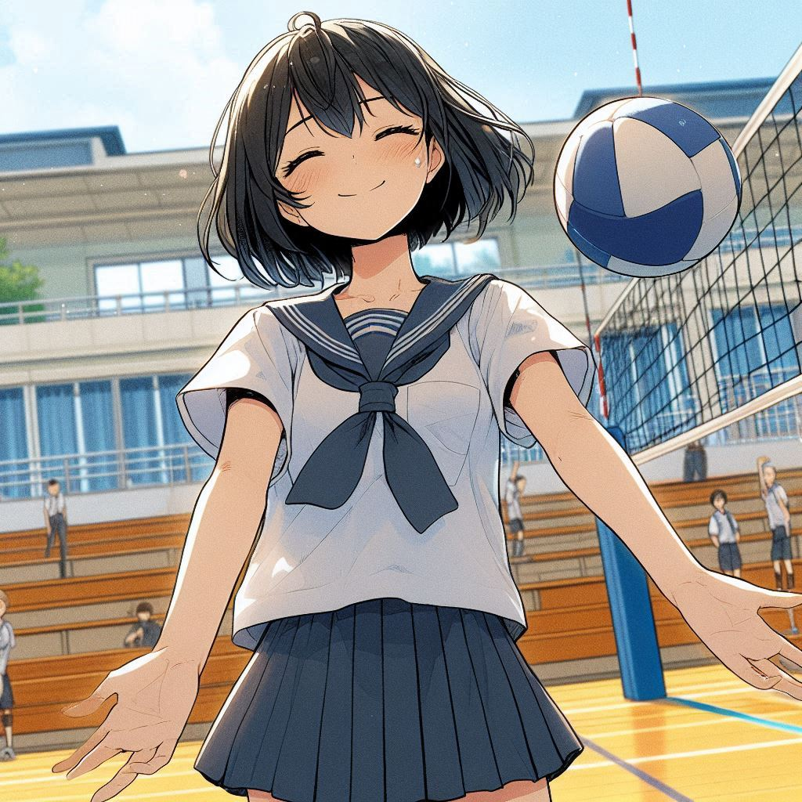
Prompt:The school girl with short black hair gradually adapted to the rhythm of the court. He successfully caught several powerful serves from his opponent and his expression became slightly more relaxed.
講稿:但隨著比賽進行，我慢慢適應了場上的節奏。幾次接發球後，我感覺到自己的動作開始流暢起來，成功接住了對手的幾個強力發球。整體表現比我預期的好很多，這讓我稍微放鬆了一些。

Slide 10
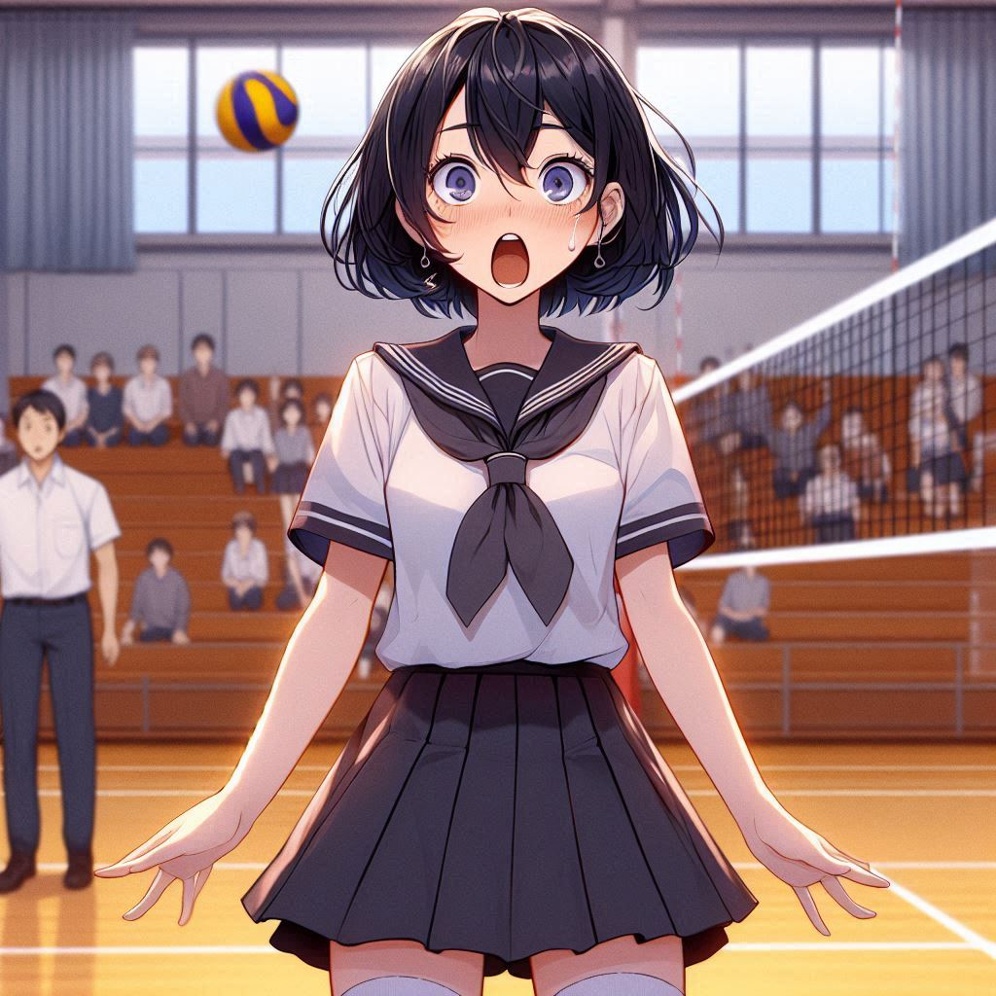
Prompt:A school girl with short black hair looked at the volleyball in amazement as it landed on the playing field.
講稿:然而，在比賽的關鍵時刻，對方突然發來一個快速旋轉的球，我反應不及，眼看著那顆球飛過我身邊，落在地上，內心瞬間充滿自責。

Slide 11
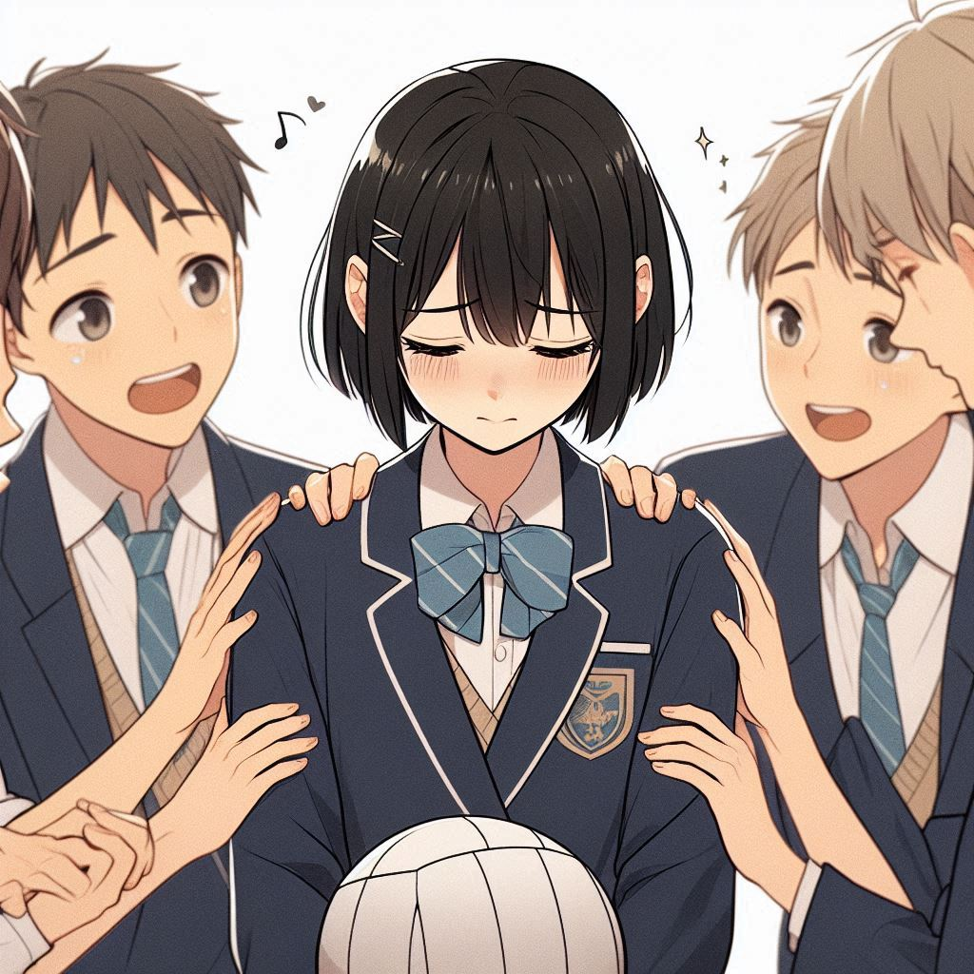
Prompt:A school girl with short black hair was playing volleyball, her teammates went over to comfort her about her mistake, which made her feel relieved a lot.
講稿:就在我懊悔時，隊友們過來拍拍我的背，笑著說：「別放在心上，這只是比賽的一部分，接下來還有機會！」這句話讓我釋然了不少。我告訴自己不要再專注於剛剛的失誤，而是要把注意力放在接下來的每一球。

Slide 12
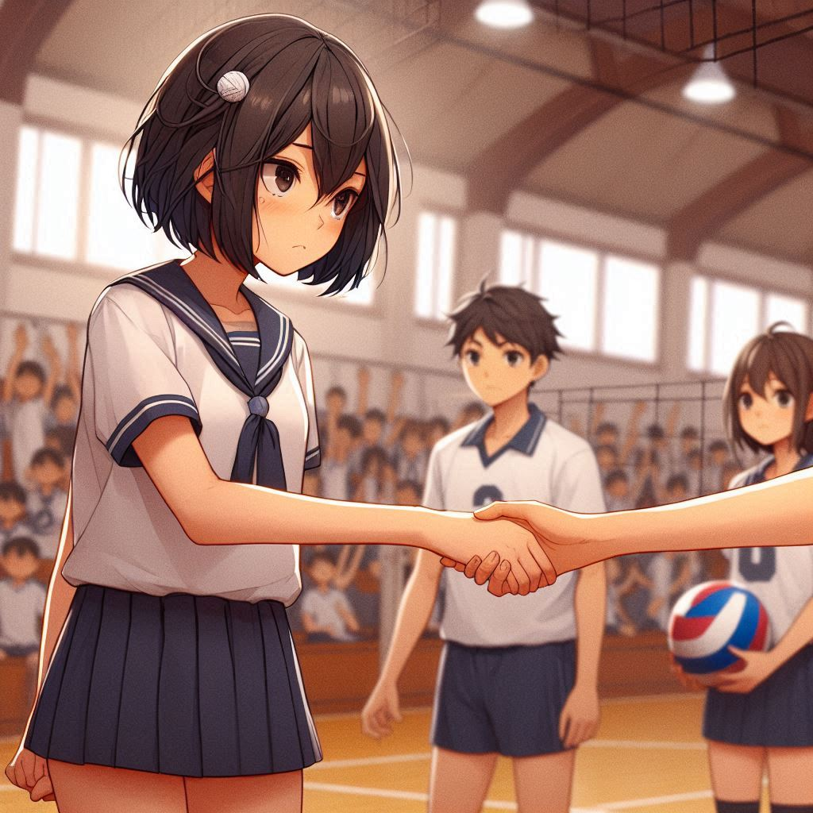
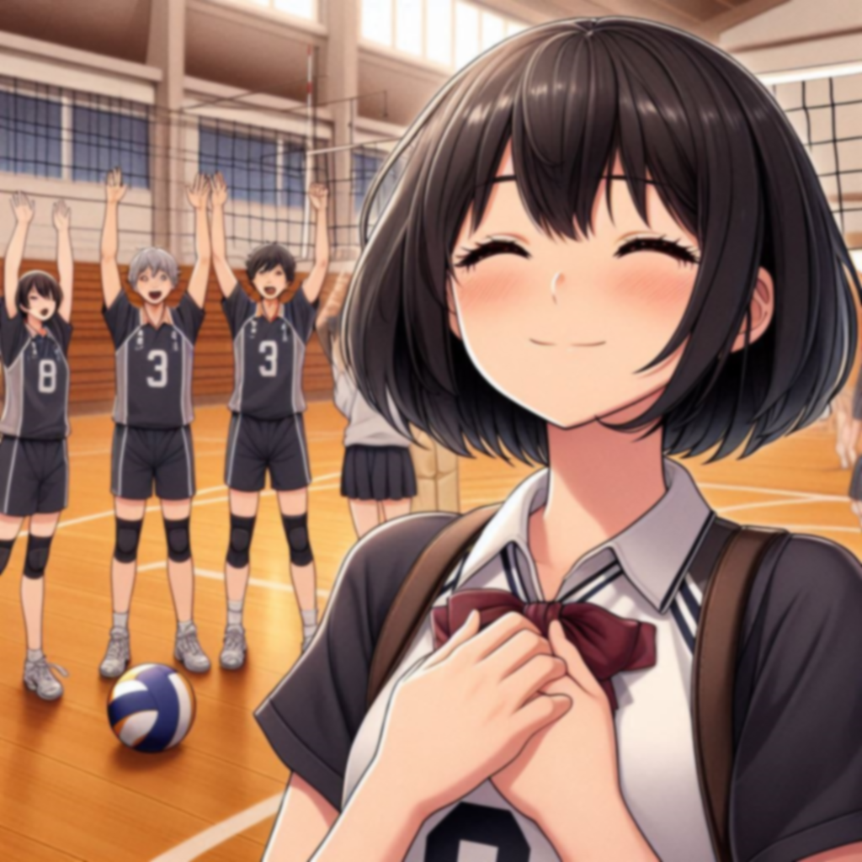
Prompt:Generate a picture of a school girl with short black hair playing with her teammates on the volleyball court, but losing the game, and finally shaking hands with her opponent.
講稿:最終，我們系隊雖然輸給了校外隊伍，但我從這次比賽中學到了很多。這次的經歷讓我明白，初次比賽難免有失誤，但最重要的是如何面對失敗，並在壓力下調整自己。

